Slide 1
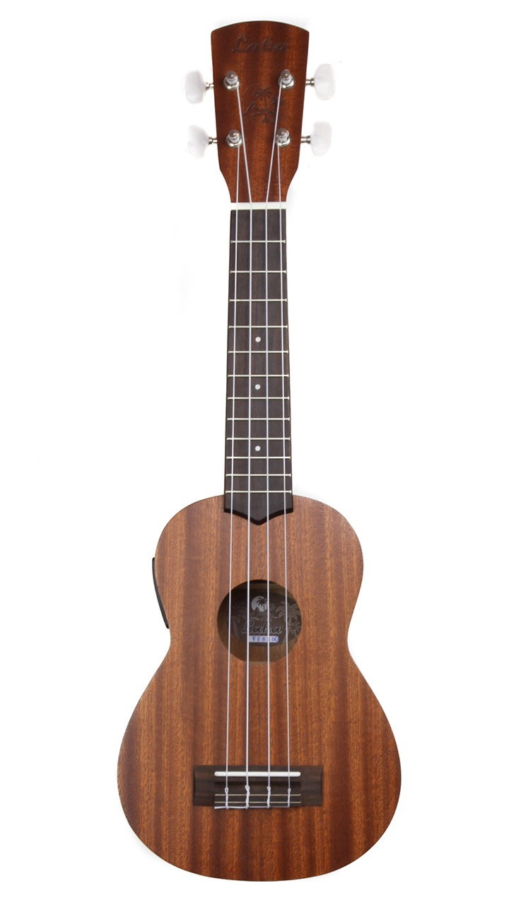
The Ukulele Song Book
An accessible ukulele learning resource

Slide 2
Created by Camilla Farrant
Music Therapy Tree, May 2021

Slide 3
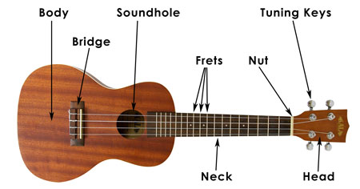
Parts of a ukulele
Notes:
JUDAH: The body, bridge and neck of the ukulele is made of wood and the tuning pegs and strings are made of metal.
SUMMER: We make a sound on the ukulele by strumming the strings, using one finger, the thumb or a plectrum.
RUZGAR: We like the plectrum best because it doesn’t hurt your fingers!

Slide 4
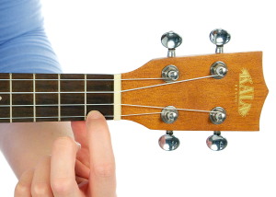
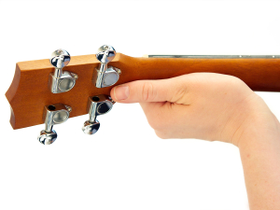
How to hold a ukulele
Notes:
DILANNA: We learned how to hold the ukulele – like this – and how to balance it on your left hand.
ROMAN: It’s much easier to hold a ukulele if you’re sitting down.

Slide 5
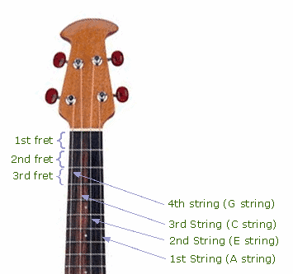
Fret numbers
Notes:
DIVINE: The lines on the neck of the ukulele show you where to put your fingers. The spaces are called frets.
TYRA: At the top are the pegs of the ukulele – you can change the notes of the strings by turning them.

Slide 6
Strings on the ukulele
G, C, E, A
Good Cats Eat Apples
Notes:
MARTINA: The strings of the ukulele are always tuned to the same notes – G, C, E and A.
ARRAN: Camilla taught us how to remember the names of the strings by singing “GOOD CATS EAT ANTS”

Slide 7
Coloured stickers for chords

Slide 8
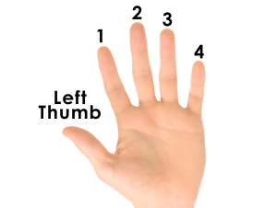
Fingers

Slide 9
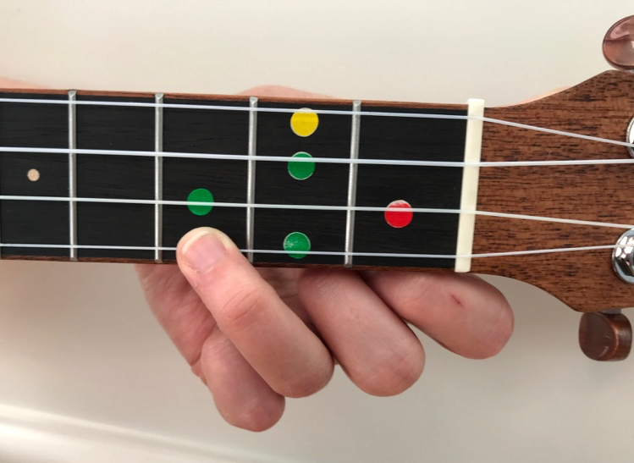
⬤ Blue Sticker (C major)
Finger 3 on the blue sticker.
Notes:
ASTRID: Next, we learnt the chord C major. It looks like this.

Slide 10
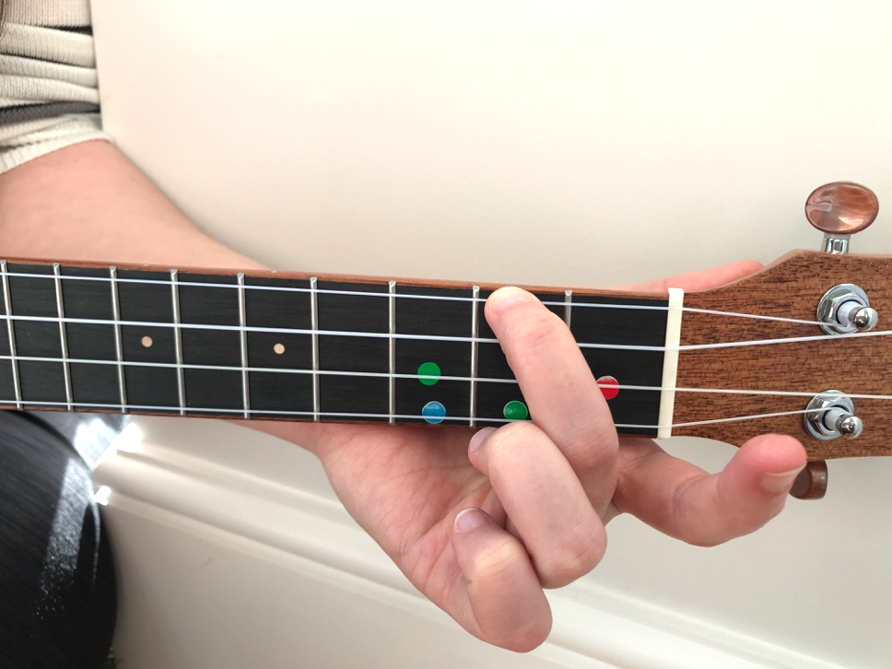
⬤ Yellow Sticker (A minor)
Finger 2 on the yellow sticker
Notes:
LUCA: Then we learned the chord of A minor.
JOSHUA: The difference between major and minor chords is that major chords sound happy (PLAY) and minor chords sound sad (PLAY)
DANIELLE: Using C major and A minor, we learned to play the song ‘Next to Me’ by Emily Sandé.

Slide 11
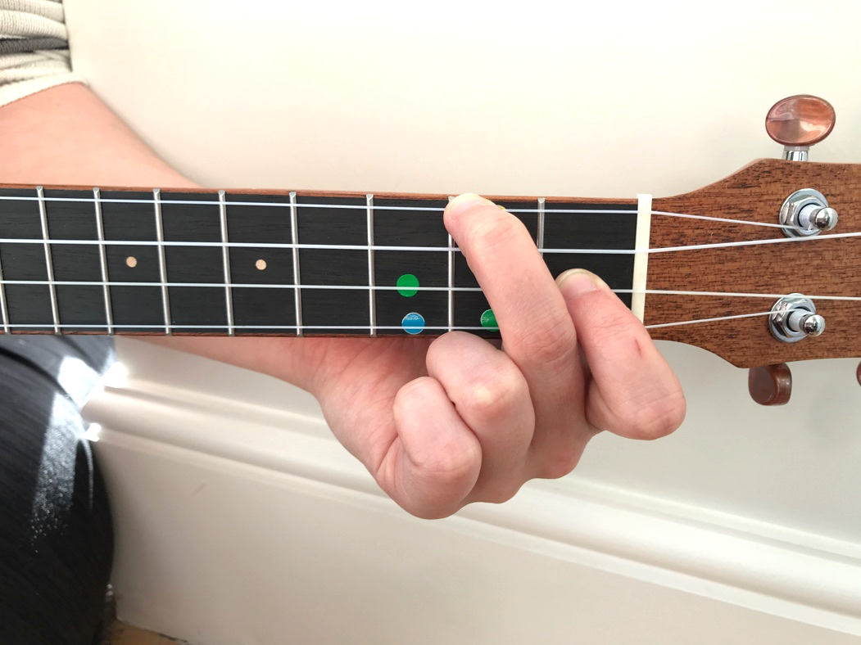
⬤⬤ Red & Yellow Sticker (F major)
Finger 1 on the yellow sticker
Finger 2 on the red sticker.
Notes:
JACOB: The first chord we learned to play was F major. It looks like this.

Slide 12
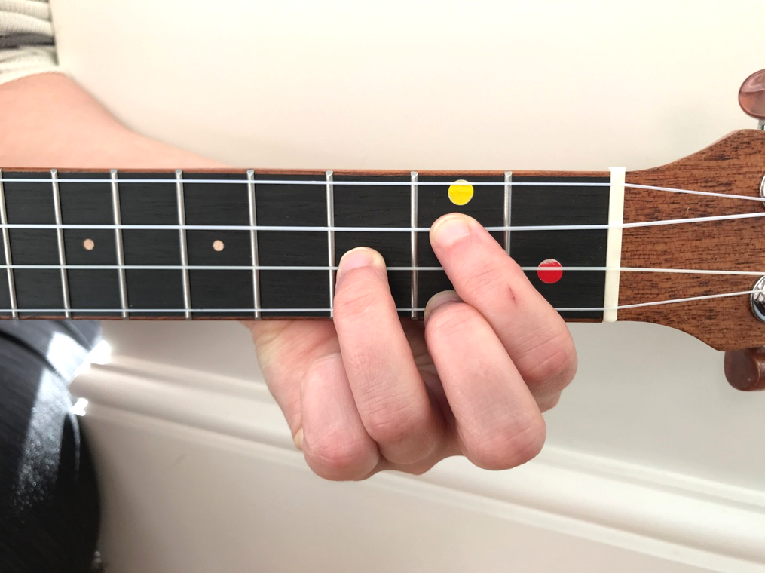
⬤ Green Stickers (G major)
Finger 1 on the upper green sticker (under yellow)
Finger 2 on the lower green sticker
Finger 3 on the middle green sticker
Notes:
AIDEN: Then we learned our final chord – G major. It looks like this.
DYLAN: G major is a bit difficult because it uses three fingers in a triangle shape.
EMELIO: Some of us will play this chord, but Camilla also showed us “Cheats G” where you only have to use one finger – it’s MUCH easier!

Slide 13
Nursery Rhymes for the ukulele

Slide 14
Baby Shark
⬤
Baby shark doo doo doo doo doo
⬤
Baby shark doo doo doo doo doo
⬤
Baby shark doo doo doo doo doo
⬤
Baby shark doo doo doo doo doo

Slide 15
⬤
Mummy shark doo doo doo doo doo
⬤
Mummy shark doo doo doo doo doo
⬤
Mummy shark doo doo doo doo doo
⬤
Mummy shark doo doo doo doo doo

Slide 16
⬤
Daddy shark doo doo doo doo doo
⬤
Daddy shark doo doo doo doo doo
⬤
Daddy shark doo doo doo doo doo
⬤
Daddy shark doo doo doo doo doo

Slide 17
⬤
Grandma shark doo doo doo doo doo
⬤
Grandma shark doo doo doo doo doo
⬤
Grandma shark doo doo doo doo doo
⬤
Grandma shark doo doo doo doo doo

Slide 18
Baa Baa Black Sheep
⬤ ⬤⬤ ⬤
Baa, baa, black sheep, have you any wool? ⬤⬤ ⬤ ⬤ ⬤
Yes sir, yes sir, three bags full!
⬤ ⬤⬤
One for the master, ⬤ ⬤
And one for the dame, ⬤ ⬤⬤
One for the little boy ⬤ ⬤
Who lives down the lane

Slide 19
Five little ducks
⬤
Five little ducks went swimming one day ⬤
Over the hill and far away ⬤
Mother duck said, "Quack, quack, quack, quack" ⬤ ⬤
But only four little ducks came back

Slide 20
⬤
Four little ducks went swimming one day ⬤
Over the hill and far away ⬤
Mother duck said, "Quack, quack, quack, quack" ⬤ ⬤
But only three little ducks came back
Three… Two… One…

Slide 21
I can sing a rainbow
⬤
Red and yellow and pink and green ⬤⬤ ⬤ ⬤
Purple and orange and blue, ⬤ ⬤⬤ ⬤
I can sing a rainbow, ⬤⬤ ⬤
Sing a rainbow, ⬤ ⬤
Sing a rainbow too.

Slide 22
⬤⬤ ⬤
Listen with your ears, ⬤⬤ ⬤
Listen with your eyes, ⬤ ⬤
And sing everything you see! ⬤
I can sing a rainbow, ⬤
Sing a rainbow, ⬤
Sing along with me...

Slide 23
⬤
Red and yellow and pink and green ⬤⬤ ⬤ ⬤
Purple and orange and blue, ⬤ ⬤⬤ ⬤
I can sing a rainbow, ⬤⬤ ⬤
Sing a rainbow, ⬤ ⬤
Sing a rainbow too.

Slide 24
Old McDonald
⬤ ⬤⬤ ⬤
Old MacDonald had a farm ⬤ ⬤ ⬤
Ee- eye, ee-eye oh! ⬤ ⬤⬤ ⬤
And on his farm he had a cow ⬤ ⬤ ⬤
Ee- eye, ee-eye oh!

Slide 25
⬤
With a moo-moo here ⬤
And a moo-moo there ⬤ ⬤
Here a moo, there a moo ⬤ ⬤
Everywhere a moo-moo
⬤ ⬤⬤ ⬤
Old MacDonald had a farm ⬤ ⬤ ⬤
Ee- eye, ee-eye oh!

Slide 26
Row row row your boat
⬤
Row, row, row your boat ⬤
Gently down the stream ⬤
Merrily merrily, merrily, merrily ⬤ ⬤ ⬤
Life is but a dream

Slide 27
Thomas and friends theme tune
⬤ ⬤ ⬤⬤ ⬤
They're two, they're four, they're six, they're eight ⬤ ⬤ ⬤⬤ ⬤
Shunting trucks and hauling freights. ⬤⬤ ⬤
Red and green and brown and blue, ⬤
They're the really useful crew.

Slide 28
⬤ ⬤ ⬤⬤ ⬤
All with different roles to play, ⬤ ⬤ ⬤⬤ ⬤
Round Tidmouth sheds or far away. ⬤⬤ ⬤
Down the hills and round the bends, ⬤ ⬤
Thomas and his friends.

Slide 29
Twinkle twinkle
⬤ ⬤⬤ ⬤
Twinkle, twinkle, little star ⬤⬤ ⬤ ⬤ ⬤
How I wonder what you are
⬤ ⬤⬤ ⬤ ⬤
Up above the world so high
⬤ ⬤⬤ ⬤ ⬤
Like a diamond in the sky
⬤ ⬤⬤ ⬤
Twinkle, twinkle, little star ⬤⬤ ⬤ ⬤ ⬤
How I wonder what you are

Slide 30
Wheels on the bus
⬤
The wheels on the bus go round and round ⬤
Round and round ⬤
Round and round ⬤
The wheels on the bus go round and round ⬤ ⬤
All day long

Slide 31
⬤
The wipers on the bus go swish, swish, swish ⬤
Swish, swish, swish ⬤
Swish, swish, swish ⬤
The wipers on the bus go swish, swish, swish ⬤ ⬤
All day long

Slide 32
Pop Songs for the ukulele

Slide 33
Blinded by your grace
⬤
Lord, I've been broken ⬤⬤
Although I'm not worthy ⬤
You fixed me, I'm blinded ⬤⬤
By your grace ⬤⬤
You came and saved me

Slide 34
Dance Monkey
⬤ ⬤⬤
They say, Oh, my God, I see the way you shine
⬤ ⬤
Take your hand, my dear, and place them both in mine
⬤ ⬤⬤
You know, you stopped me dead while I was passing by
⬤ ⬤
And now I beg to see you dance just one more time

Slide 35
⬤ ⬤⬤
Ooh, I see you, see you, see you every time
⬤ ⬤
And oh, my I-I, I-I like your style
⬤ ⬤⬤
You, you make me, make me, make me wanna cry
⬤
And now I beg to see you dance just one more time

Slide 36
⬤ ⬤⬤
So I say dance for me, dance for me, dance for me, oh-oh-oh
⬤ ⬤
I never seen anybody do the things you do before
⬤ ⬤⬤
They say move for me, move for me, move for me, ay-ay-ay
⬤ ⬤
And when you're done I'll make you do it all again

Slide 37
Don’t stop believing
⬤ ⬤
Just a small town girl ⬤ ⬤⬤
Livin' in a lonely world ⬤ ⬤ ⬤ ⬤⬤
She took the midnight train going anywhere ⬤ ⬤
Just a city boy
⬤ ⬤⬤
Born and raised in south Detroit ⬤ ⬤ ⬤ ⬤⬤
He took the midnight train going anywhere

Slide 38
⬤ ⬤
A singer in a smoky room ⬤ ⬤⬤
A smell of wine and cheap perfume ⬤ ⬤
For a smile they can share the night ⬤ ⬤⬤
It goes on and on, and on, and on

Slide 39
⬤⬤
Strangers waiting ⬤
Up and down the boulevard ⬤⬤ ⬤
Their shadows searching in the night ⬤⬤
Streetlights, people ⬤
Living just to find emotion ⬤⬤ ⬤
Hiding somewhere in the night

Slide 40
⬤ ⬤
Working hard to get my fill ⬤ ⬤⬤
Everybody wants a thrill ⬤ ⬤
Payin' anything to roll the dice ⬤ ⬤⬤
Just one more time

Slide 41
⬤ ⬤
Some will win, some will lose
⬤ ⬤⬤
Some were born to sing the blues
⬤ ⬤
Oh, the movie never ends ⬤ ⬤⬤
It goes on and on, and on, and on

Slide 42
⬤⬤
Strangers waiting ⬤
Up and down the boulevard ⬤⬤ ⬤
Their shadows searching in the night ⬤⬤
Streetlights, people ⬤
Living just to find emotion ⬤⬤ ⬤
Hiding somewhere in the night

Slide 43
⬤ ⬤
Don't stop believing
⬤ ⬤⬤
Hold on to the feeling ⬤ ⬤ ⬤ ⬤⬤
Streetlights, people…………………………
repeat

Slide 44
Don’t worry about a thing
⬤
Don't worry about a thing, ⬤⬤ ⬤
Cause every little thing is gonna be alright. ⬤
Singing, don't worry about a thing, ⬤⬤ ⬤
Cause every little thing is gonna be alright!

Slide 45
⬤
Rise up this morning ⬤
Smiled with the rising sun,
⬤
Three little birds
⬤⬤
Pitch by my doorstep
⬤
Singing sweet songs
⬤
Of melodies pure and true, ⬤⬤ ⬤ ⬤
Saying, this is my message to you-ou-ou:

Slide 46
⬤
Don't worry about a thing, ⬤⬤ ⬤
Cause every little thing is gonna be alright. ⬤
Singing, don't worry about a thing, ⬤⬤ ⬤
Cause every little thing is gonna be alright!

Slide 47
Eye of the Tiger
⬤ ⬤⬤
Risin' up, back on the street
⬤ ⬤
Did my time, took my chances
⬤ ⬤⬤
Went the distance now I'm back on my feet
⬤ ⬤
Just a man and his will to survive

Slide 48
⬤⬤
It's the eye of the tiger
⬤ ⬤
It's the thrill of the fight
⬤⬤ ⬤
Rising up to the challenge of our rival
⬤⬤ ⬤ ⬤
And the last known survivor stalks his prey in the night
⬤⬤ ⬤⬤ ⬤
And he's watching us all with the eye of the tiger

Slide 49
A-string, A-string, middle ⬤, A-string
A-string, middle ⬤, A-string
A-string, middle ⬤, ⬤

Slide 50
⬤ ⬤⬤
So many times, it happens too fast
⬤ ⬤
You trade your passion for glory
⬤ ⬤⬤
Don't lose your grip on the dreams of the past
⬤ ⬤
You must fight just to keep them alive

Slide 51
⬤⬤
It's the eye of the tiger
⬤ ⬤
It's the thrill of the fight
⬤⬤ ⬤
Rising up to the challenge of our rival
⬤⬤ ⬤ ⬤
And the last known survivor stalks his prey in the night
⬤⬤ ⬤⬤ ⬤
And he's watching us all with the eye of the tiger

Slide 52
Hakuna Matata
⬤⬤ ⬤
Hakuna Matata! What a wonderful phrase
⬤⬤ ⬤
Hakuna Matata! Ain't no passing craze ⬤
It means no worries
⬤⬤ ⬤
For the rest of your days
⬤⬤ ⬤
It's our problem-free, philosophy... ⬤
Hakuna Matata!

Slide 53
⬤⬤ ⬤ ⬤
When he was a young warthog... ⬤⬤ ⬤ ⬤
When I was a young warthoooog! ⬤⬤ ⬤
He found his aroma lacked a certain appeal
⬤⬤ ⬤
He could clear the savannah after every meal

Slide 54
⬤⬤ ⬤ ⬤
I'm a sensitive soul, though I seem thick-skinned ⬤ ⬤
And it hurt that my friends never stood downwind
⬤ ⬤
And oh the shame! Though of changing my name
⬤⬤
And I got downhearted, every time that I…
⬤
Pumbaa! Not in front of the kids! Oh... sorry.

Slide 55
⬤⬤ ⬤
Hakuna Matata! What a wonderful phrase
⬤⬤ ⬤
Hakuna Matata! Ain't no passing craze ⬤
It means no worries
⬤⬤ ⬤
For the rest of your days
⬤⬤ ⬤
It's our problem-free, philosophy... ⬤
Hakuna Matata!

Slide 56
Just the way you are
⬤
Her eyes, her eyes make the stars look like
⬤
they're not shinin’ ⬤
Her hair, her hair falls perfectly without her trying ⬤⬤ ⬤
She's so beautiful and I tell her everyday

Slide 57
⬤
Yeah, I know, I know when I compliment her
⬤
she won't believe me ⬤
And it's so, it's so sad to think that she don't
⬤
see what I see
⬤⬤ ⬤
But every time she asks me "Do I look okay?” I say……

Slide 58
⬤
When I see your face
⬤
There's not a thing that I would change
⬤⬤
Cause you're amazing ⬤
Just the way you are

Slide 59
⬤
And when you smile
⬤
The whole world stops and stares for a while ⬤⬤
'Cause girl you're amazing ⬤
Just the way you are

Slide 60
Living on a prayer
⬤
Tommy used to work on the docks,
⬤
Union's been on strike ⬤ ⬤⬤
He's down on his luck, it's tough,
⬤ ⬤
So tough

Slide 61
⬤
Gina works the diner all day
⬤
Working for her man ⬤ ⬤⬤
She brings home her pay, for love,
⬤ ⬤
For love

Slide 62
⬤⬤ ⬤ ⬤
She says, we've got to hold on to what we've got ⬤⬤ ⬤ ⬤
It doesn't make a difference if we make it or not ⬤⬤ ⬤ ⬤ ⬤⬤
We've got each other and that's a lot for love ⬤
We'll give it a shot

Slide 63
⬤ ⬤⬤ ⬤
Woah, we're half way there ⬤ ⬤⬤ ⬤
Woah, living on a prayer
⬤ ⬤⬤ ⬤
Take my hand, we'll make it I swear ⬤ ⬤⬤ ⬤ ⬤
Woah, living on a prayer

Slide 64
Million Dreams
⬤ ⬤ ⬤
I close my eyes and I can see
⬤⬤ ⬤
The world that's waiting up for me
⬤ ⬤⬤
That I call my own
⬤ ⬤ ⬤
Through the dark, through the door
⬤⬤ ⬤
Through where no one's been before
⬤ ⬤⬤
But it feels like home

Slide 65
⬤ ⬤⬤
They can say, they can say it all sounds crazy
⬤ ⬤⬤
They can say, they can say I've lost my mind
⬤ ⬤⬤
I don't care, I don't care, so call me crazy
⬤ ⬤⬤
We can live in a world that we design

Slide 66
⬤
'Cause every night I lie in bed
⬤
The brightest colours fill my head
⬤ ⬤⬤
A million dreams are keeping me awake
⬤
I think of what the world could be
⬤
A vision of the one I see

Slide 67
⬤ ⬤⬤
A million dreams is all it's gonna take
⬤⬤ ⬤
A million dreams for the world we're gonna make

Slide 68
⬤ ⬤ ⬤
There's a house we can build
⬤⬤ ⬤
Every room inside is filled
⬤ ⬤⬤
With things from far away
⬤ ⬤ ⬤
The special things I compile
⬤⬤ ⬤
Each one there to make you smile
⬤ ⬤⬤
On a rainy day

Slide 69
⬤ ⬤⬤
They can say, they can say it all sounds crazy
⬤ ⬤⬤
They can say, they can say I've lost my mind
⬤ ⬤⬤
I don't care, I don't care, so call me crazy
⬤ ⬤⬤
We can live in a world that we design

Slide 70
⬤
'Cause every night I lie in bed
⬤
The brightest colours fill my head
⬤ ⬤⬤
A million dreams are keeping me awake
⬤
I think of what the world could be
⬤
A vision of the one I see

Slide 71
⬤ ⬤⬤
A million dreams is all it's gonna take
⬤⬤ ⬤
A million dreams for the world we're gonna make

Slide 72
Next to me
⬤ ⬤
You won’t find him drinking at the table ⬤ ⬤
Rolling dice or staying out ’til three ⬤ ⬤
You won’t ever find him be unfaithful ⬤⬤ ⬤⬤ ⬤
You will find him, you’ll find him next to me

Slide 73
⬤ ⬤
You won’t find him try to chase the devil ⬤ ⬤
For money, fame, for power, out of greed ⬤ ⬤
You won’t ever find him where the rest go ⬤⬤ ⬤⬤ ⬤
You will find him, you’ll find him next to me

Slide 74
⬤ ⬤
Next to me, ooh hooo ⬤ ⬤
Next to me, ooh hooo ⬤ ⬤
Next to me, ooh hooo ⬤⬤ ⬤⬤ ⬤
You will find him, you’ll find him next to me

Slide 75
Old Town Road
⬤ ⬤
Yeah, I'm gonna take my horse to the old town road ⬤ ⬤⬤
I'm gonna ride 'til I can't no more ⬤ ⬤
I'm gonna take my horse to the old town road
⬤ ⬤⬤
I'm gonna ride 'til I can't no more

Slide 76
⬤
I got the horses in the back ⬤
Horse tack is attached ⬤
Hat is matte black ⬤⬤
Got the boots that's black to match

Slide 77
⬤
Ridin' on a horse, ha
⬤
You can whip your Porsche ⬤
I been in the valley ⬤⬤
You ain't been up off that porch, now

Slide 78
⬤ ⬤
Can't nobody tell me nothing ⬤ ⬤⬤
You can't tell me nothing ⬤ ⬤
Can't nobody tell me nothing ⬤ ⬤⬤
You can't tell me nothing

Slide 79
Roar
⬤
I used to bite my tongue and hold my breath ⬤
Scared to rock the boat and make a mess ⬤ ⬤⬤
So I sat quietly, agreed politely
⬤
I guess that I forgot I had a choice ⬤
I let you push me past the breaking point ⬤ ⬤⬤
I stood for nothing, so I fell for everything

Slide 80
⬤
You held me down, but I got up (hey!) ⬤
Already brushing off the dust ⬤
You hear my voice, you hear that sound
⬤⬤
Like thunder, gonna shake the ground ⬤
You held me down, but I got up (hey!) ⬤
Get ready 'cause I had enough ⬤
I see it all, I see it now

Slide 81
⬤⬤ ⬤
I got the eye of the tiger, a fighter ⬤
Dancing through the fire ⬤
'Cause I am a champion,
⬤⬤ ⬤
and you're gonna hear me roar ⬤
Louder, louder than a lion ⬤
'Cause I am a champion,
⬤⬤ ⬤
and you're gonna hear me roar

Slide 82
⬤
Oh oh oh oh oh oh oh oh ⬤
Oh oh oh oh oh oh oh oh ⬤
Oh oh oh oh oh oh oh oh ⬤⬤ ⬤
You're gonna hear me roar!

Slide 83
Señorita
⬤
I love it when you call me Señorita ⬤
I wish I could pretend I didn't need ya ⬤⬤
But every touch is ooh-la-la-la ⬤⬤
It's true la-la-la ⬤
Ooh I should be running ⬤ ⬤
Ooh you keep me coming for ya

Slide 84
⬤
Land in Miami
⬤ ⬤
The air was hot from summer rain sweat dripping off me
⬤ ⬤⬤
Before I even knew her name la-la-la ⬤
It felt like ooh-la-la-la, yeah

Slide 85
⬤
Sapphire moonlight ⬤ ⬤
We danced for hours in the sand Tequila Sunrise ⬤ ⬤⬤
Her body fit right in my hands, la-la-la ⬤
It felt like ooh-la-la-la, yeah

Slide 86
⬤
I love it when you call me Señorita ⬤
I wish I could pretend I didn't need ya ⬤⬤
But every touch is ooh-la-la-la ⬤⬤
It's true la-la-la ⬤
Ooh I should be running ⬤ ⬤
Ooh you keep me coming for ya

Slide 87
⬤
I love it when you call me Señorita ⬤
I wish it wasn’t so damn hard to leave ya ⬤⬤
But every touch is ooh-la-la-la ⬤⬤
It's true la-la-la ⬤
Ooh I should be running ⬤ ⬤
Ooh you keep me coming for ya

Slide 88
Shot Gun
⬤ ⬤⬤
Home grown alligator, see you later
⬤ ⬤
Gotta hit the road, gotta hit the road
⬤
Something changed in the atmosphere,
⬤⬤
Architecture unfamiliar,
⬤ ⬤
I could get used to this

Slide 89
⬤ ⬤⬤
Time flies by in the yellow and green,
⬤ ⬤
stick around and you’ll see what I mean.
⬤ ⬤⬤
There’s a mountain top, that I’m dreaming of,
⬤ ⬤
If you need me, you know where I’ll be.

Slide 90
⬤ ⬤⬤
I’ll be riding shotgun, Underneath the hot sun,
⬤ ⬤
Feeling like a someone.
⬤ ⬤⬤
I’ll be riding shotgun, Underneath the hot sun,
⬤ ⬤
Feeling like a someone.

Slide 91
⬤ ⬤⬤
The south of the equator, navigator,
⬤ ⬤
Gotta hit the road, gotta hit the road.
⬤
Deep-sea diving round the clock,
⬤⬤
Bikini bottoms, lager tops
⬤ ⬤
I could get used to this

Slide 92
⬤ ⬤⬤
Time flies by in the yellow and green,
⬤ ⬤
stick around and you’ll see what I mean.
⬤ ⬤⬤
There’s a mountain top, that I’m dreaming of,
⬤ ⬤
If you need me, you know where I’ll be.

Slide 93
⬤ ⬤⬤
I’ll be riding shotgun, Underneath the hot sun,
⬤ ⬤
Feeling like a someone.
⬤ ⬤⬤
I’ll be riding shotgun, Underneath the hot sun,
⬤ ⬤
Feeling like a someone.

Slide 94
This is me
⬤ ⬤ ⬤
I am not a stranger to the dark ⬤⬤ ⬤
Hide away, they say ⬤
'Cause we don't want your broken parts ⬤ ⬤ ⬤
I've learned to be ashamed of all my scars ⬤⬤ ⬤
Run away, they say ⬤
No one'll love you as you are

Slide 95
⬤⬤ ⬤ ⬤
But I won't let them break me down to dust ⬤ ⬤
I know that there's a place for us ⬤
For we are glorious

Slide 96
⬤
When the sharpest words wanna cut me down ⬤
I'm gonna send a flood, gonna drown them out ⬤⬤
I am brave, I am bruised ⬤ ⬤
I am who I'm meant to be, this is me

Slide 97
⬤
Oh-oh-oh-oh (oh-oh-oh-oh) ⬤
Oh-oh-oh-oh (oh-oh-oh-oh) ⬤⬤
Oh-oh-oh ⬤⬤
Oh-oh-oh ⬤
Oh-oh-oh, oh, oh
⬤
This is me

Slide 98
We will rock you
⬤
Buddy, you're a boy, make a big noise ⬤ ⬤
Playing in the street, gonna be a big man someday ⬤
You got mud on your face, you big disgrace ⬤ ⬤
Kicking your can all over the place, singing

Slide 99
⬤⬤ ⬤ ⬤
We will, we will rock you ⬤⬤ ⬤ ⬤
We will, we will rock you

Slide 100
⬤
Buddy, you're a young man, hard man ⬤
Shouting in the street,
⬤
Gonna take on the world someday
⬤
You got mud on your face, you big disgrace ⬤ ⬤
Waving your banner all over the place, singing

Slide 101
⬤⬤ ⬤ ⬤
We will, we will rock you ⬤⬤ ⬤ ⬤
We will, we will rock you
⬤⬤ ⬤ ⬤
We will, we will rock you ⬤⬤ ⬤ ⬤
We will, we will rock you

